Slide 1

COMP90050
Advanced Database Systems
Winter Semester, 2023
Lecturer: Farhana Choudhury (PhD)
Week 3 part 4

Slide 2
What we have seen in previous lecture
Problems may arise from multiple concurrent transactions
Concurrency control is needed
    Take exclusive access to shared resources to handle concurrency problems
    In this lecture we will see the concurrency control more formally and in more details

Slide 3
Isolation Concepts – I in ACID
Isolation ensures that concurrent transactions leaves the database in the same state as if the transactions were executed separately.
Isolation guarantees consistency, provided each transaction itself is consistent.

Slide 4
Isolation – expected output example
Shared counter = 100;
Task1/Trans/Process/Thread
counter = counter +10;
Task2/Trans/Process/Thread
counter = counter +30;
Task1 and Task2 run concurrently.
  counter == 110
  Sequence of actions
  T1: Reads counter == 100
  T2: Reads counter == 100
  T2: Writes counter == 100+30
  T1: Writes counter == 100+10
  b) counter == 130
  Sequence of actions
  T1: Reads counter == 100
  T2: Reads counter == 100
  T1: Writes counter == 100+10
  T2: Writes counter == 100+30
  c) counter == 140;
  Sequence of actions
  T1: Reads counter == 100
  T1: Writes counter == 100+10
  T2: Reads counter == 110
  T2: Writes counter == 110+30
Alternatively, T2 executing before T1 will also have the same state

Slide 5
Isolation Concepts ...
We can achieve isolation by sequentially processing each transaction - generally not efficient and provides poor response times.
We need to run transactions concurrently with the following goals:
  concurrent execution should not cause application programs (transactions) to malfunction.
  Concurrent execution should not have lower throughput or bad response times than serial execution.
To achieve isolation we need to understand dependency of operations

Slide 6
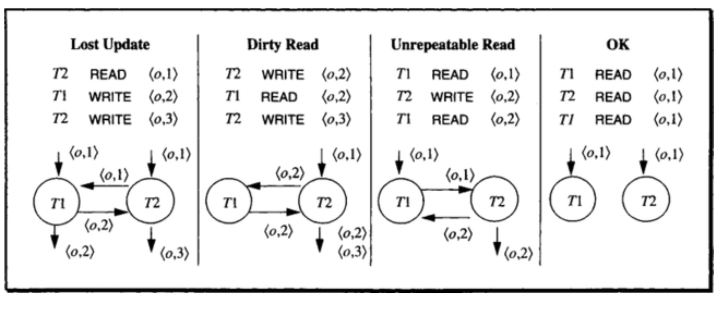
Possible dependencies

Slide 7
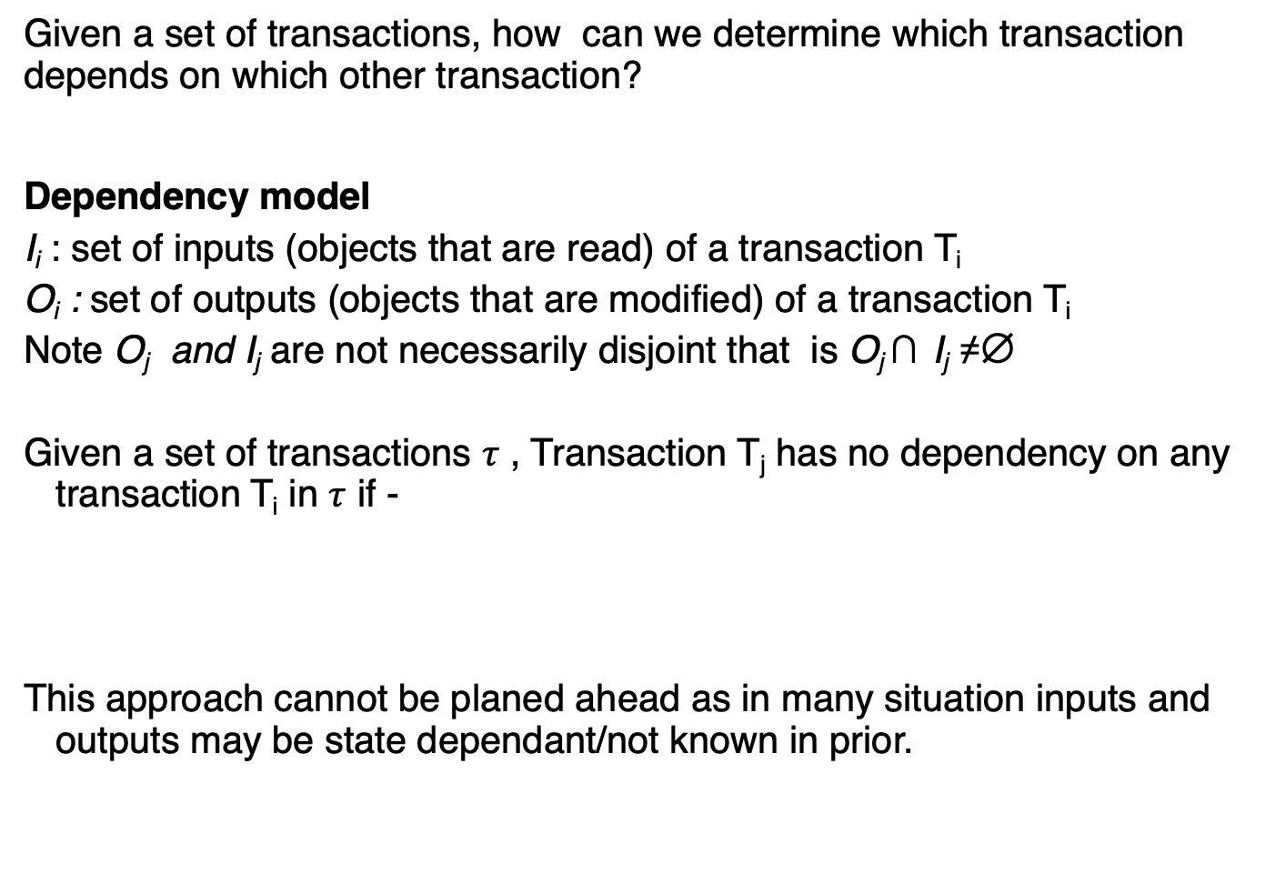
How can we find the dependencies?
Given a set of transactions, how can we determine which transaction depends on which other transaction?
Dependency model
  I_{i} : set of inputs (objects that are read) of a transaction T_{i}
  O_{i} : set of outputs (objects that are modified) of a transaction T_{i}
  Note O_{j} and I_{j} are not necessarily disjoint that is O_{j} ∩ I_{j} ≠∅
  Given a set of transactions $τ$ , Transaction T_{j} has no dependency on any transaction T_{i} in $τ$ if -
  This approach cannot be planed ahead as in many situation inputs and outputs may be state dependant/not known in prior.

Slide 8
 | T₁ | T₂ | T₃ | T₄
Trans In ∪ Out (I_{i}∪O_{i}) | O_{i}∩ (I₁∪O₁) | O_{i}∩ (I₂∪O₂) | O_{i}∩ (I₃∪O₃) | O_{i}∩ (I₄∪O₄)
T₁ | O₁ | ∅ | ∅ | ∅
T₂ | ∅ | O₂ | ∅ | ∅
T₃ | ∅ | ∅ | O₃ | ∅
T₄ | ∅ | ∅ | ∅ | O₄

Slide 9
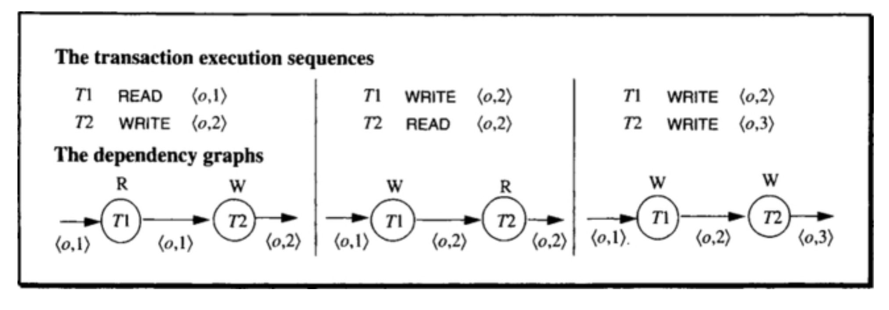
If the inputs and outputs of the concurrent transactions are not disjoint, the following dependencies can occurs –
Read-Read dependency do not affect isolation
Fig 7.1 in the main reference book

Slide 10
Dependencies
When dependency graph has cycles then there is a violation of isolation and a possibility of inconsistency.
% T2 did not see the update of T1
  What if T2 aborts?
  T1’s read will be
  invalid
  The value of o changes by another transaction T2 while T1 is still running

Slide 11
Formal definition of dependency
Let H is a history sequence of tuples of the form (T, action, object).
Let T1 and T2 are transactions in H. If T1 performs an action on an object O, then T2 performs an action on the same O, and there is no write action in between by another transaction on O – then T2 depends on T1.
Formally, the dependency of T2 on T1 (T1, O, T2) exists in history H if there are indexes i and j such that i < j, H[i] involves action a1 on O by T1, (i.e., H[i] = (T1,a1,O)) and H[j] involves action a2 on O by T2 (i.e., H(j) = (T2, a2,O)) and there are no other H[k] = (T’,WRITE,O) for i < k < j
Dependency graph : Transactions are nodes, and object labels
the edges from the node Ti to Tj if (Ti, O, Tj) is in DEP(H).

Slide 12
Dependency relations
We focus on the dependency in three scenarios
  a1 = WRITE & a2 = WRITE;
  a1 = WRITE & a2 = READ;
  a1 = READ & a2 = WRITE (dependency as T1 may read again after a2).
  These are also called WRITE --> WRITE, WRITE --> READ and READ --> WRITE dependency respectively.

Slide 13
Dependency relations - equivalence
DEP(H) = { (Ti, O, Tj) | Tj depends on Ti }.
Given two histories H1 and H2 contain the same tuples, H1 and H2 are equivalent if DEP(H1) = DEP(H2)
This implies that a given database will end up in exactly the same final
state by executing either of the sequence of operations in H1 or H2
E.g.,
H1 = <(T1,R,O1), (T2, W, O5), (T1,W,O3), (T3,W,O1), (T5,R,O3), (T3,W,O2), (T5,R,O4), (T4,R,O2), (T6,W,O4)>
DEP(H1) = {<T1, O1,T3>, <T1,O3,T5>, <T3,O2,T4>, <T5,O4,T6> }
H2 = <(T1,R,O1), (T3,W,O1), (T3,W,O2),(T4,R,O2),(T1,W,O3), (T2, W, O5), (T5,R,O3), (T5,R,O4), (T6,W,O4)>
DEP(H2) = {<T1, O1,T3>, <T1,O3,T5>, <T3,O2,T4>, <T5,O4,T6> }
DEP(H1) = DEP(H2)

Slide 14
Dependency relations - equivalence
H1 = <(T1,R,O1), (T2, W, O5), (T1,W,O3), (T3,W,O1), (T5,R,O3), (T3,W,O2), (T5,R,O4), (T4,R,O2), (T6,W,O4)>
H2 = <(T1,R,O1), (T3,W,O1), (T3,W,O2),(T4,R,O2),(T1,W,O3), (T2, W, O5), (T5,R,O3), (T5,R,O4), (T6,W,O4)>
DEP(H1) = {<T1, O1,T3>, <T1,O3,T5>, <T3,O2,T4>, <T5,O4,T6> }
DEP(H2) = {<T1, O1,T3>, <T1,O3,T5>, <T3,O2,T4>, <T5,O4,T6> }
O1
T3
O2
T4
T1
D1
O1,O2,O3,O4
H1
O3
D0
O1,O2,O3,O4
T2
T5
H2
D2
O1,O2,O3,O4
O4
T6
State of D1 = State of D2

Slide 15
Isolated history
A history is said to be isolated if it is equivalent to a serial history (as if all transactions are executed serially/sequentially)
A serial history is history that is resulted as a consequence of
running transactions sequentially one by one. N transactions
can result in a maximum of N! serial histories.
If T1 precedes T2,
it is written as T1 << T2.
Before(T) = {T’ | T’ << T}
After(T) = {T’| T << T’}
E.g. After(T1) = {T5,T6, T3, T4}
After(T3) = {T4}
After (T5) = {T6}
After(T3) = {T4}
T3
T4
T1
T2
T5
T6

Slide 16
Isolation Concepts ...
A transaction T’ is called a wormhole transaction if
That is T << T’ << T. This implies there is a cycle in the
dependency graph of the history. Presence of a wormhole
transaction implies it is not isolated (=> not a serial schedule).
A history is serial if it runs one transaction at a time sequentially, or equivalent to a serial history.
A serial history is an isolated history.
Wormhole theorem: A history is isolated if and only if it has no wormholes.

Slide 17
We will now introduce a new type of lock -
SLOCK (shared lock) that allows other transactions to read, but not write/modify the shared resource
The wormhole transaction concept will be useful in a later topic!

Slide 18
To grant lock or not to…
A lock on an object should not be granted to a transaction while that object is locked by another transaction in an incompatible mode.
Lock Compatibility Matrix
 | Mode of Lock
Current Mode | Free | Shared | Exclusive
Shared request (SLOCK) Used to block others writing/modifying | Compatible Request granted immediately Changes Mode from Free to Shared | Compatible Request granted immediately Mode stays Shared | Conflict Request delayed until the state becomes compatible Mode stays Exclusive
Exclusive request (XLOCK) Used to block others reading or writing/modifying | Compatible Request granted immediately Changes Mode from Free to Exclusive | Conflict Request delayed until the state becomes compatible Mode stays Shared | Conflict Request delayed until the state becomes compatible Mode stays Exclusive

Slide 19
When to use what type of lock
Actions in Transactions are: READ, WRITE, XLOCK, SLOCK, UNLOCK, BEGIN, COMMIT, ROLLBACK
T1
BEGIN
SLOCK A
XlOCK B
READ A
WRITE B
COMMIT
UNLOCK A
UNLOCK B
END
T2
BEGIN
SLOCK A
XlOCK B
READ A
WRITE B
ROLLBACK
UNLOCK A
UNLOCK B
END

Slide 20
Isolation Concepts ...
BEGIN, END , SLOCK, XLOCK can be ignored as they can be automatically inserted in terms of the corresponding operations
E.g. if a transaction ends with a COMMIT, it is replaced with:
{UNLOCK A if SLOCK A or XLOCK A appears in T for any object A}. (That is to simply release all locks)
Similarly ROLLBACK can be replaced by
{WRITE(UNDO) A if WRITE A appears in T for any object A}
{ UNLOCK A if SLOCK A or XLOCK A appears in T for any object A}.

Slide 21
Isolation Concepts ...
We can replace previous transaction sequences by:
T2
BEGIN
SLOCK A
READ A
XLOCK B
WRITE B
WRITE (UNDO) B
UNLOCK A
UNLOCK B
END
T1
READ A
WRITE B
COMMIT
T1
BEGIN
SLOCK A
READ A
XLOCK B
WRITE B
UNLOCK A
UNLOCK B
END
T2
READ A
WRITE B
ROLLBACK

Slide 22
Isolation Concepts ...
Well-formed transactions: A transaction is well formed if all READ, WRITE and UNLOCK operations are covered by appropriate LOCK operations
Two phase transactions: A transaction is two phased if all LOCK operations precede all its UNLOCK operations.

Slide 23
Isolation Theorems
Summary:
A transactions is a sequence of READ, WRITE, SLOCK, XLOCK actions on objects ending with COMMIT or ROLLBACK.
A transaction is well formed if each READ, WRITE and UNLOCK operation is covered earlier by a corresponding lock operation.
A history is legal if does not grant conflicting grants.
A transaction is two phase if its all lock operations precede its unlock operations.

Slide 24
Isolation Theorems
Locking theorem: If all transactions are well formed (READ, WRITE and UNLOCK operation is covered earlier by a corresponding lock operation) and two-phased (locks are released only at the end), then any legal (does not grant conflicting grants) history will be isolated.
Locking theorem (Converse): If a transaction is not well formed or is not two-phase, then it is possible to write another transaction such that it is a wormhole.
Rollback theorem: An update transaction that does an UNLOCK and then does a ROLLBACK is not two phase.

Slide 25
Degrees of Isolation
Degree 3
Slock(A)
Xlock(B)
Xlock(C)
Read(A)
Write(B)
Read(A)
Write(C)
Unlock(A)
Unlock(B)
Unlock(C)
Phase1
Degree 3: A Three degree isolated Transaction has no lost updates, and has repeatable reads. This is “true” isolation.
  Lock protocol is two phase and well formed.
  It is sensitive to the following conflicts:
  write->write; write ->read; read->write
Degree 2: A Two degree isolated transaction has no lost updates and no dirty reads.
  Lock protocol is two phase with respect to exclusive locks and well formed with respect to Reads and writes. (May have Non repeatable reads.)
  It is sensitive to the following conflicts:
  write->write; write ->read;
Phase2
Degree 2
Slock(A)
Read(A)
Unlock(A)
Xlock(C)
Xlock(B)
Write(B)
Slock(A)
Read(A)
Unlock(A)
Write(C)
Unlock(B)
Unlock(C)
Phase1
With X-locks
Phase2
With X-locks

Slide 26
Degree 1
Read(A)
Xlock(C)
Xlock(B)
Write(B)
Read(A)
Write(C)
Unlock(B)
Unlock(C)
Degree 1: A One degree isolation has no lost updates.
  Lock protocol is two phase with respect to exclusive locks and well formed with respect to writes.
  It is sensitive the following conflicts:
  write->write;
Degree 0 : A Zero degree transaction does not overwrite another transactions dirty data if the other transaction is at least One degree.
  Lock protocol is well-formed with respect to writes.
  It ignores all conflicts.
Phase1
Phase2
Degree 0
Read(A)
Xlock(B)
Write(B)
Unlock(B)
Read(A)
Xlock(C)
Write(C)
Unlock(C)
Protecting
writes
Protecting
writes

